Slide 1

REAL OR FAKE NEWS ANALYSIS

Slide 2
P - 306 REAL OR FAKE NEWS ANALYSIS GROUP 2
Guided By:
Nehagupta
Presented By:
Mr. Pavan R
Mr. Kalidindi Ananda Venkata Rakumar
Ms. Shivangi Thakur
Mr. SANJEEV RAJ S
Mr. Subham Samal
Pavan D N
Mr. Abhishek Tukaram Warfade

Slide 3
CONTENT
Introduction
Problem Definition
Project Objective
Workflow
Deployment
Result

Slide 4
Introduction
Fake news exist way before social media but it multifold when social media was introduced.
Fake news is a news designed deliberately spread hoaxes, propaganda and disinformation.
Fake news stories usually spread through social media sites like Facebook, X etc.

Slide 5
Problem Definition
By clicking on a clickbait, users are led to a page that contains false information,
Fake news influences people perceptions.
The raise of fake news as become a global problem that even major tech companies like Facebook and google are struggling to solve. It can be difficult to determine whether a text is factual without additional context and human judgement.

Slide 6
Objective
The objectives of the Real or Fake News Analysis System project are:
This project aims to develop a method for detecting and classifying the news stories using Natural Language Processing.
The main goal is to identify real or fake news, which is a classic text classification issue.
We gathered our data, preprocessed the text, and translated our articles into supervised model features.
Our goal is to develop a model that classifies a given news articles as either real or fake.

Slide 7

NATURAL LAGUAGE PROCESSING(NLP)
Attempts to use Artificial Intelligence technologies specifically machine/deep learning techniques and natural language processing(NLP) to automatically detect fake news and stop it from spreading.
It can possible to teach to a computer how to learn and understand the differences between real news and fake news using Natural Language Processing.

Slide 8
WORKFLOW
Data Set loading.
Data Pre-Processing (remove stop words, stemming, Drop duplicate and remove meaningless char from the text.)
Feature selection
Applying Classification and model Construction.
Classifying the new data.

Slide 9
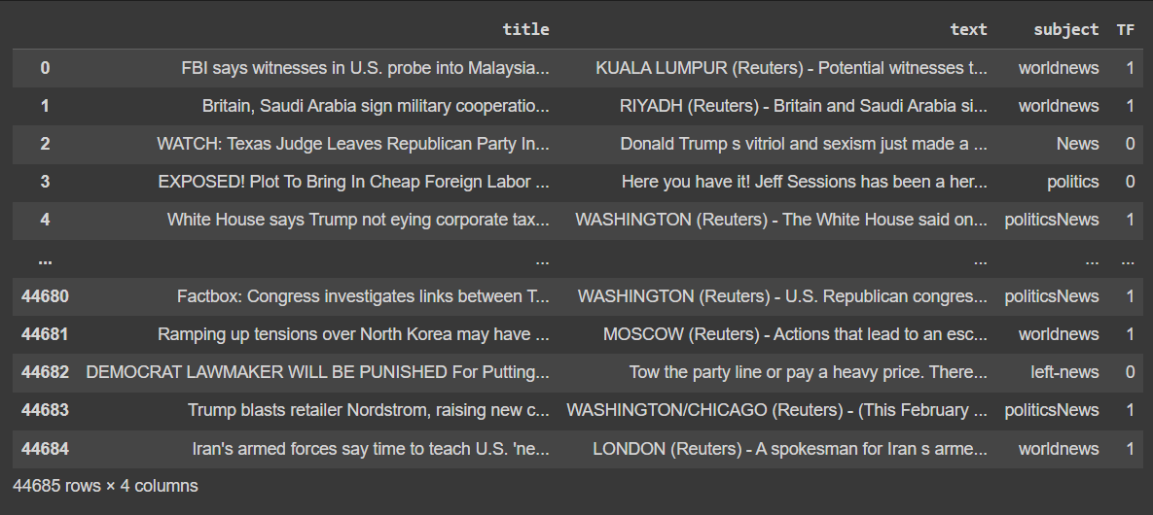
DATA SET
Initially, we possessed two datasets: one comprising real news and the other, fake news. We performed a merge, shuffle and preprocessing on both the datasets. subsequently our final dataset comprises 44685 rows and 4 columns.
Dataset contains columns:
Title: which is headline or topic of the news.
Text : Detailed content of the news.
Subject: Categorization of news(e.g., world news, politics
TF: binary indicator of real or fake news.

Slide 10
TECHNIQUES
We used TF-IDF for feature extraction.
We trained our data by using Logistic Regression, XGBoost classifier, RandomForest classifier algorithms.
We tested the efficiency of the classifier using accuracy.

Slide 11
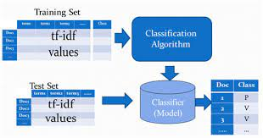
ARCHITECTURE
Extract the features from the pre-processed data using TF-IDF vectorization.
Split the dataset to training data and testing data.
Using classification algorithm train the model with feature extracted training data.
Test and Validate the model with the test data.
We used classification algorithm Logistic regression, Random Forest classifier and XGBoost classifier to model and validate the data loaded.
Compare the accuracy of all the model.

Slide 12
TF - IDF
It denotes Term Frequency and Inverse Document Frequency.
TF-IDF may be used to separate stop-words in a variety of subjects such as text summarization and classification.
TF (x) = (Number of time a word x appears in a document)/
(Total number of words in the document).
IDF (x) = log_e(Total number of documents / Number of document with word x in it).
Using TF-IDF with n-grams means looking at group of words, not just single words, to understand text better. This helps capture more context from word pairs or sequences, making it great for improving how we analyze text in tasks like natural language processing

Slide 13
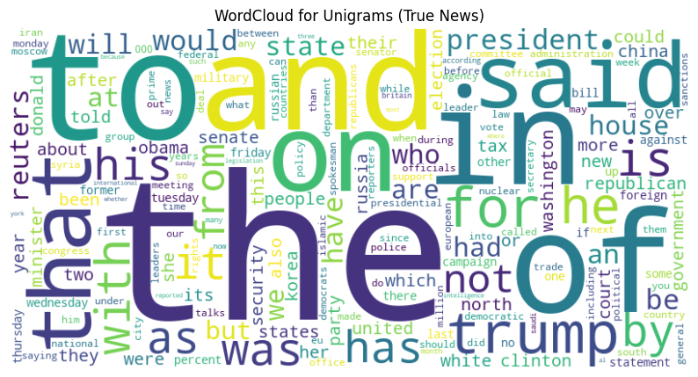
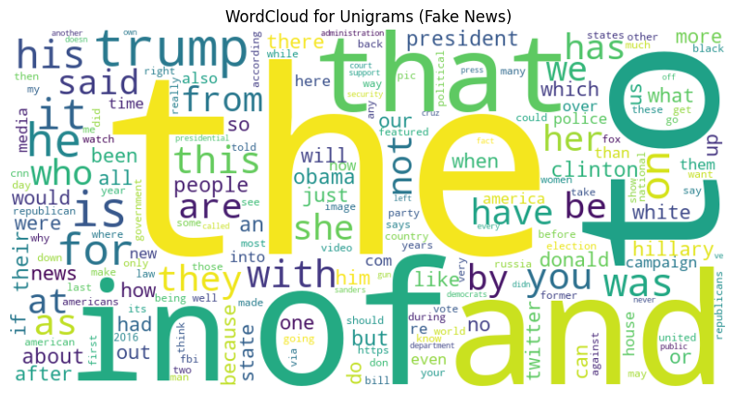
TF-IDF WORLDCLOUD REPRESENTATIONS
UNIGRAM FOR TRUE NEWS
UNIGRAM FOR FAKE NEWS

Slide 14
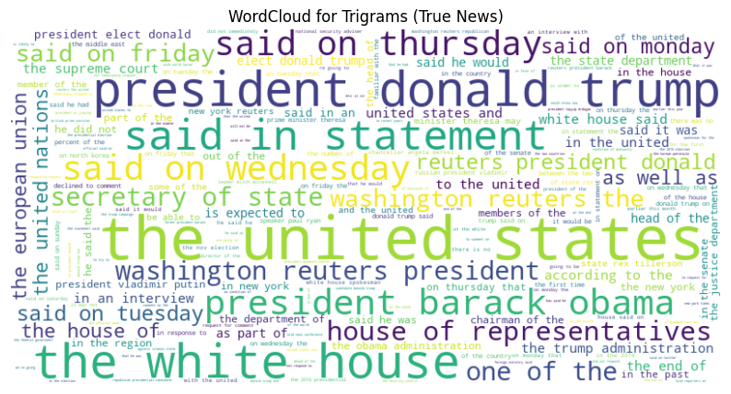
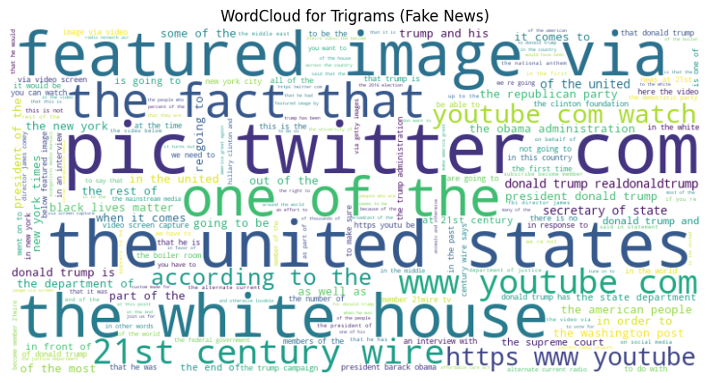
WORLD CLOUD FOR TRIGRAMS

Slide 15
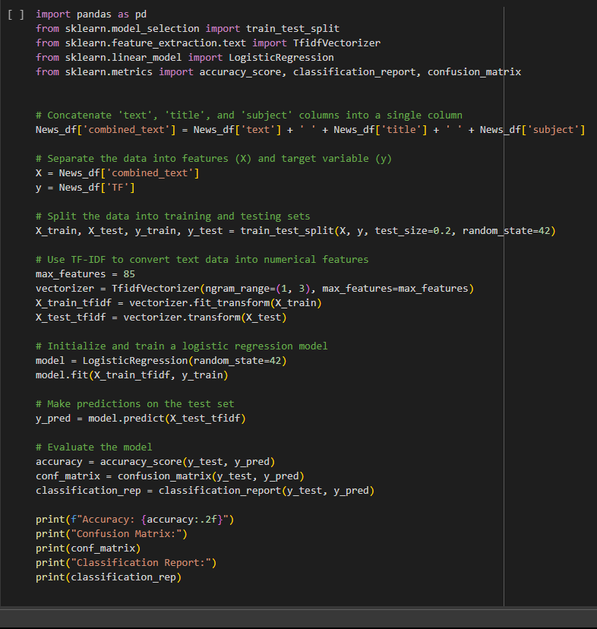
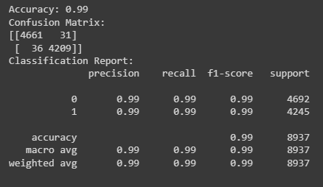
BUILDING A MODEL WITH TF-IDF
As unigrams and bigrams is giving high accuracy with 99% we went with both.

Slide 16
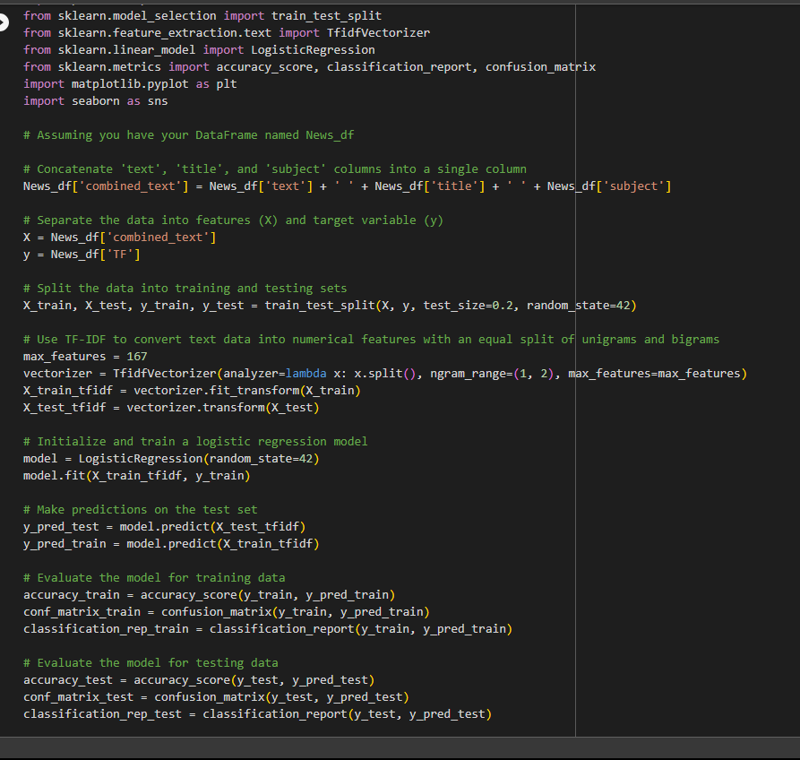
Logistic Regression
Logistic regression is a supervised learning algorithm used for classification tasks.
It works by predicting binary outcomes such as yes/no, true/false, real/fake.
It draws a line that best separates the data points of two different classes.

Slide 17
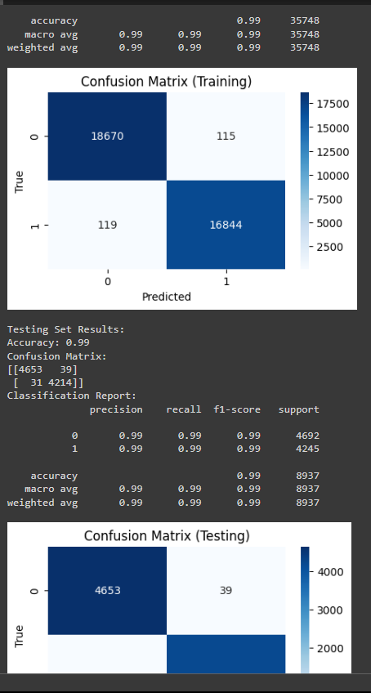
CONFUSION MATRIX
To gauge how well our model performs, we utilized a confusion matrix for both the training and testing datasets.
Our logistic regression model achieved a 99% accuracy on both training and testing datasets.

Slide 18
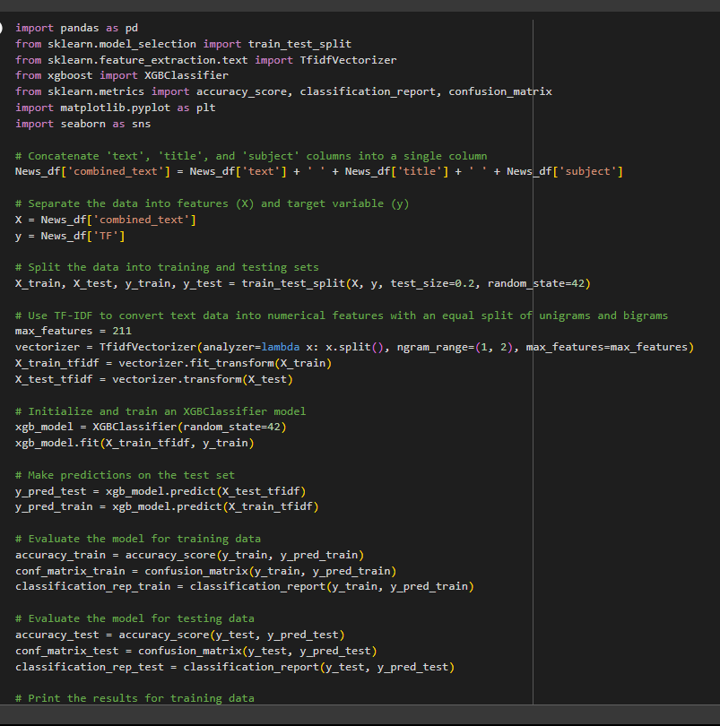
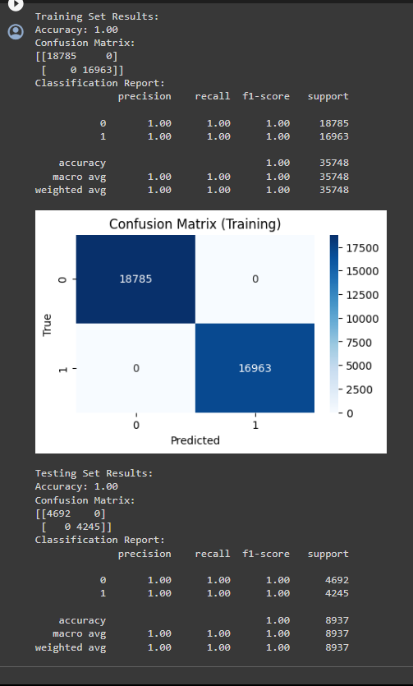
XGBoost Classifier

Slide 19
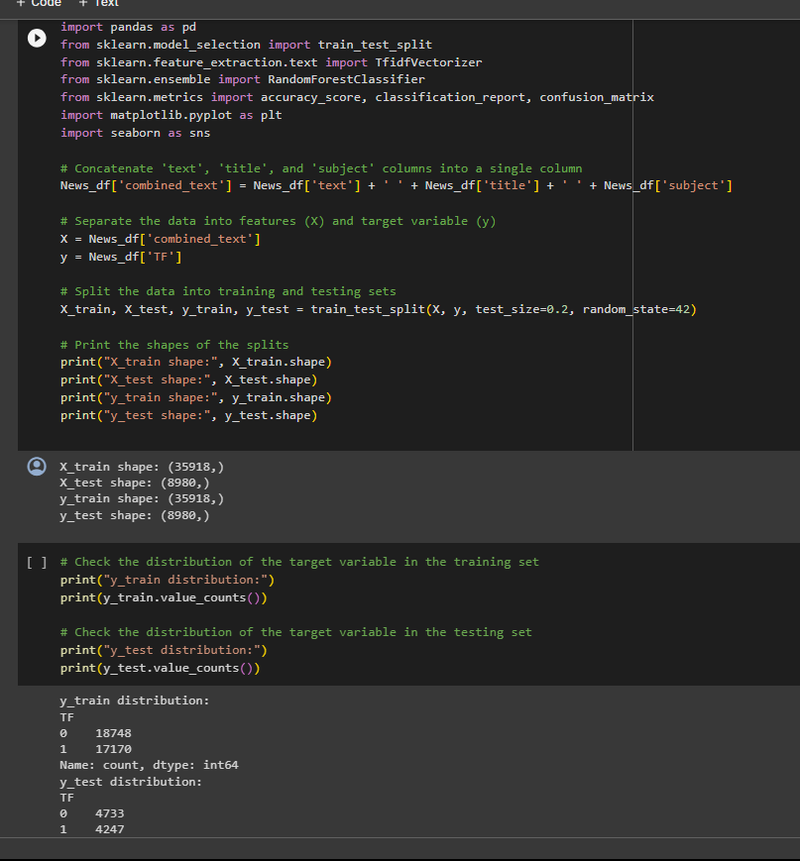
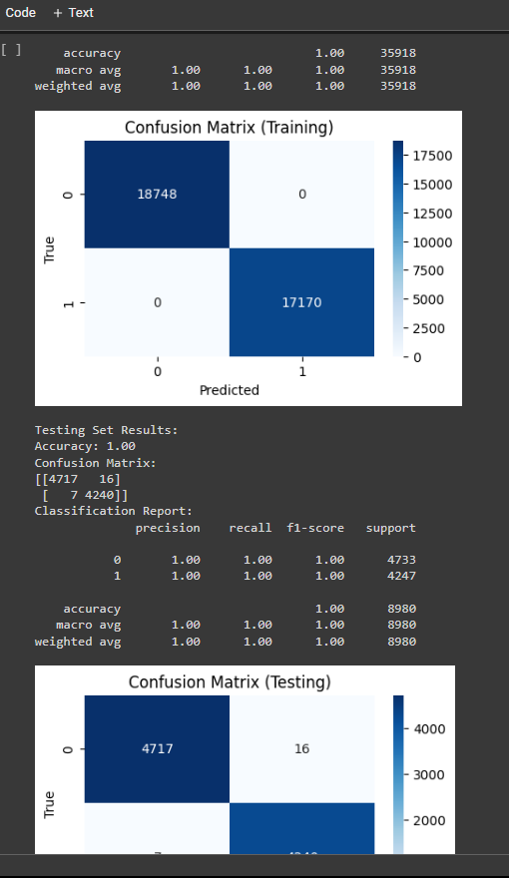
RANDOM FOREST CLASSIFIER

Slide 20
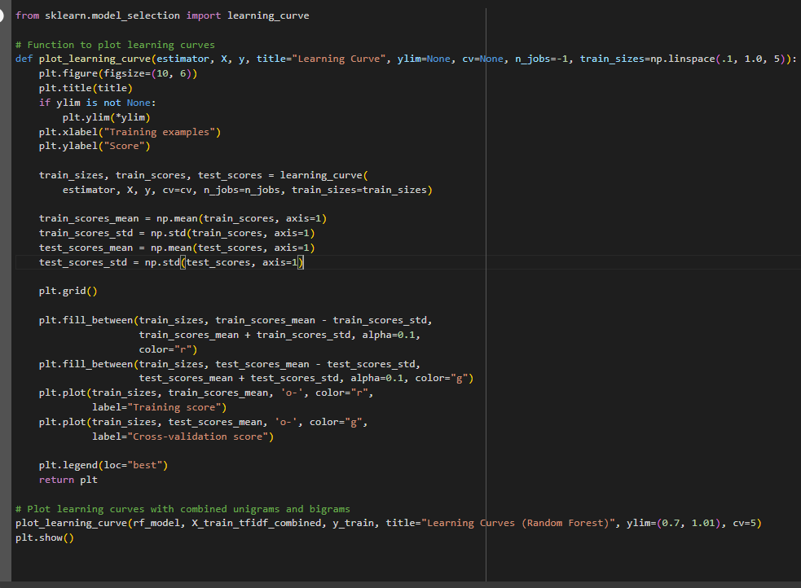
CHECKING BIAS VARIANCE TRADEOFF
Balancing simplicity and complexity in model is a key.
Bias, an over simplified model, can miss patterns(underfitting), while variance, being too sensitive in data, catches noise.
Finding the best spot means a model gets important patterns without making things too complicated. This helps with understand new information really well.

Slide 21
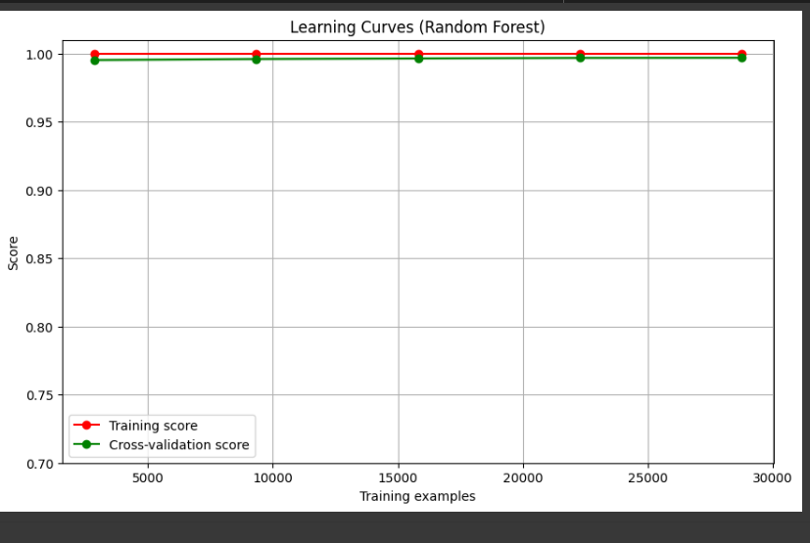
High scores in training and cross – validation signal an excellent fit. This means our model has low bias and low variance, making it a strong match for handling data effectively.

Slide 22
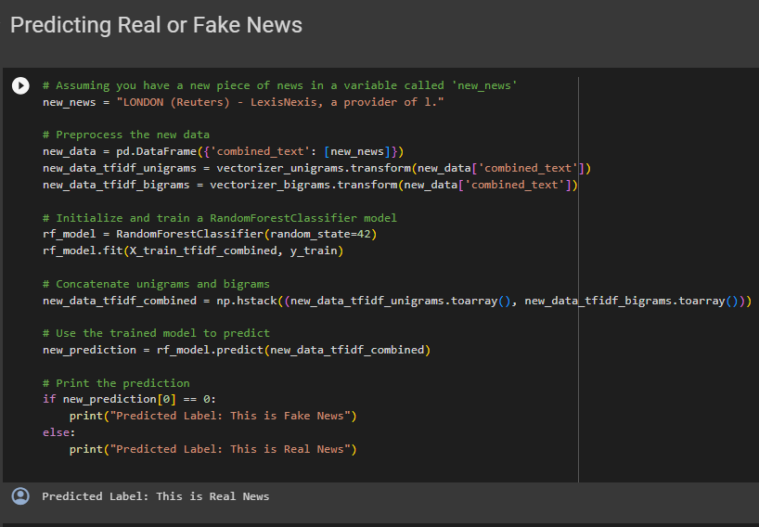
PREDICTING REAL OR FAKE NEWS

Slide 23
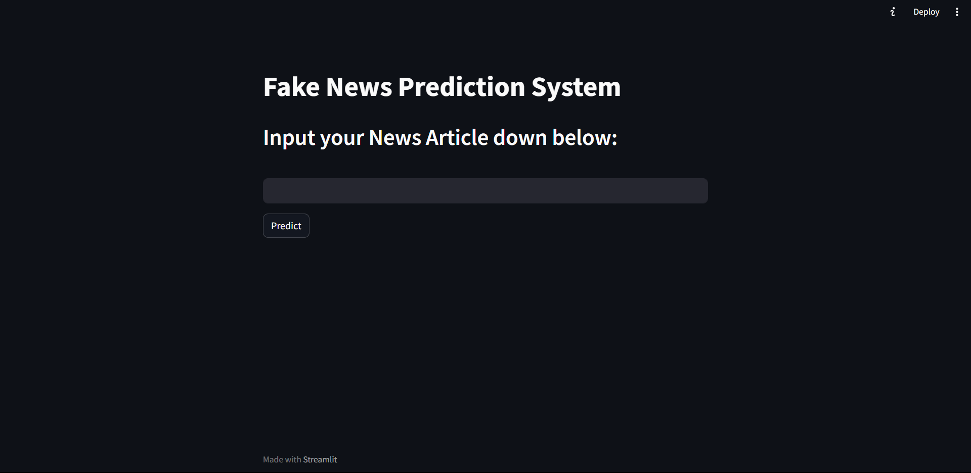
DEPLOYMENT

Slide 24
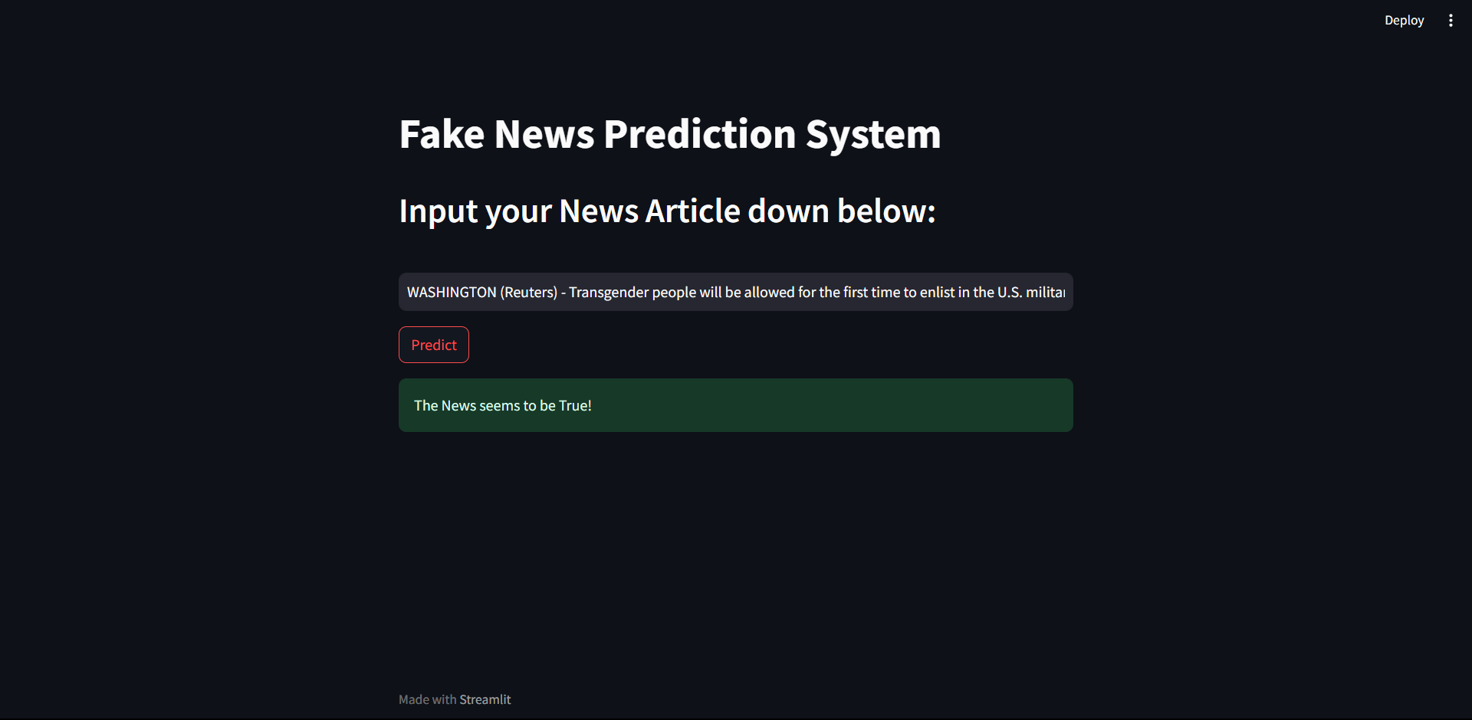
RESULT

Slide 25
THANKYOU

